Slide 1


FestGuide
Fatima Khalid, Adrian Martin, Kamal Al Shawa, Jasmine Mathers, Rida Zameer, Mauricio Rodriguez Rios, Krishna Chilukuri

Slide 2
What is FestGuide?
Festivals and events are a crucial aspect of culture and society today.
Planning and attending such events are complicated tasks
Organization
Communication
Resource Management
FestGuide is a one-stop platform for both event planners and attendees to track all things festival!

Slide 3
Objectives and Features
Our goal is to eliminate the need for multiple platforms when planning and attending festivals.
Connect event planners with target audience attendees
In-app ticket purchasing
Real-time communication between host and attendees
Safety
No more messy Instagram story announcements
Attendees can collaborate to create event updates as well
Festival data insights and attendee engagement

Slide 4



Competitor Analysis

Slide 5
Cost Estimations - Effort
Function Points (FP) Method: Used for estimating cost and effort.
Total FP: 114.4 (Calculated from EI, EO, EQ, ILF, ELF with complexity adjustments).
Person Weeks: 23 weeks (Assuming 5 FP per person per week).
Project Duration: Approx. 3 weeks and 2 days, with additional week added as buffer.
Notes:
The estimated cost for developing the app includes approximately $62,575.52 in personnel costs, $3500 to $15,000+ per month for Oracle Cloud Infrastructure, and around $72 per month for database services, with additional costs from payment processing fees via Stripe.

Slide 6
Cost Estimations - Product
Oracle Cloud Infrastructure (OCI):
Monthly Cost: $3500 basic, up to $15000+ for advanced options.
Features: Virtual machines, database automation, data recovery.
Software Stack: Python/Django, HTML/CSS/JS
Open-source and free.
Database and Payment Integration:
MySQL with Heatwave: Approx. $72 per month.
Stripe Payments: 2.9% + $0.30 per successful transaction.

Slide 7
Cost Estimations - Personnel
Team Size: 7 developers
Salary Costs: Avg $41.79/hour; total cost approx. $62,575.52 for the project duration.
Training Costs: $1250 per employee, totaling $8750.

Slide 8
Project Timeline
Project Initialization and Requirement Analysis - June 3
Align stakeholders and participants based on completed analyses
Assemble team
System Design - June 10
Create more detailed diagrams for use cases, architecture, sequence, and classes.
Implementation - June 15
Develop functionalities for event creation, ticket sales, real-time communication, and user feedback.
Code backend services and integrate payment processing: Stripe.
Develop front-end interfaces: Python/Django, HTML/CSS/JS.
Testing - June 26
Conduct unit and integration testing
Deployment - July 1
Deploy on Oracle Cloud Infrastructure
Finalize documentation
Post-Launch Activities - Beyond deadline if permitted
Monitor performance

Slide 9
Functional Requirements
Adding/editing event information (name, date, time, location)
Event search and display based on event information
In-app ticket purchasing
Event detail access
Capability to share events to external platforms
Notes:
And more

Slide 10
Non Functional Requirements
User authentication and data protection
In compliance with GDPR
Scalability for increasing number of users/events
Reliable error handling and logging
Regular software maintenance and debugging
Fast performance and friendly UI for user interactions
At least 500.55 MB daily storage

Slide 11
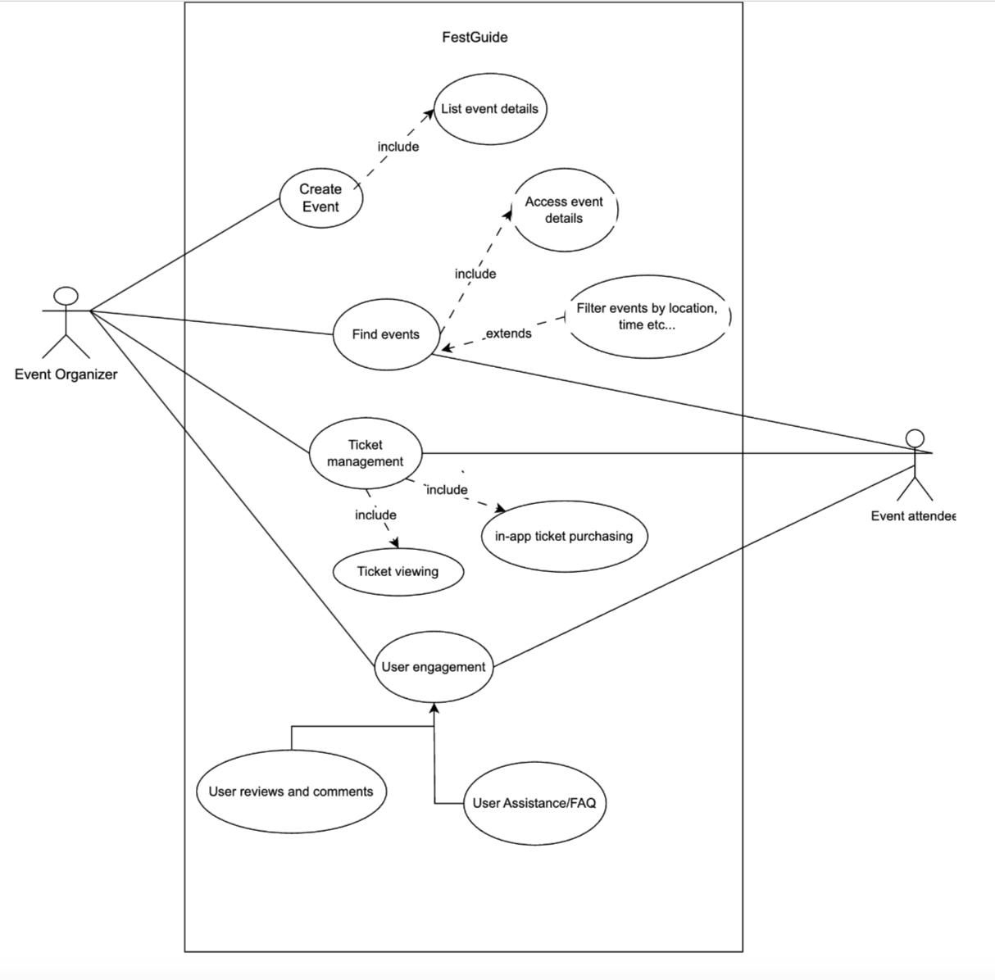
Use Case Diagram

Slide 12
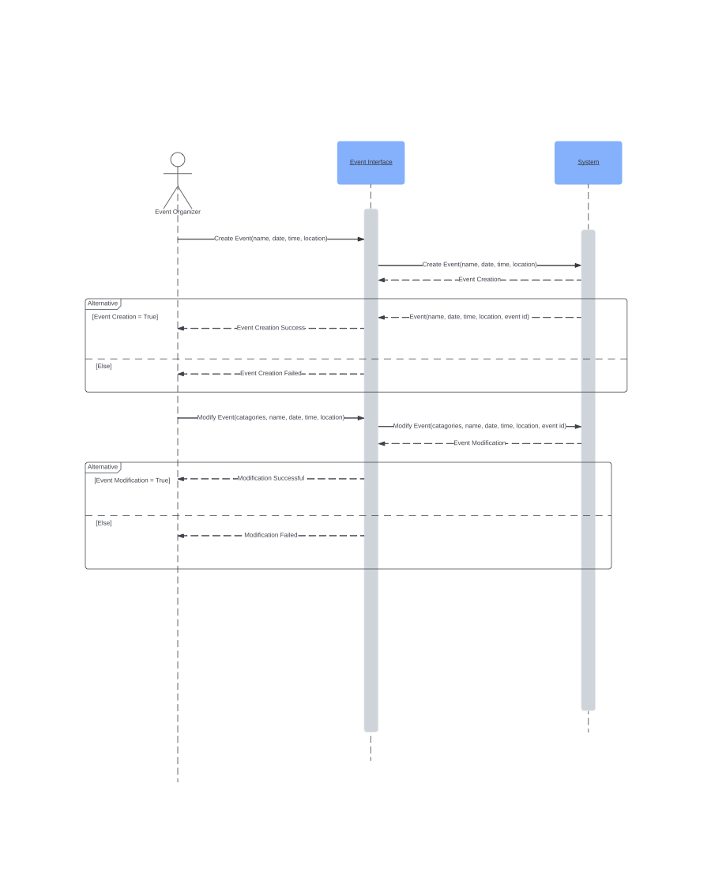
Sequence
Diagram
-
Event
Creation

Slide 13
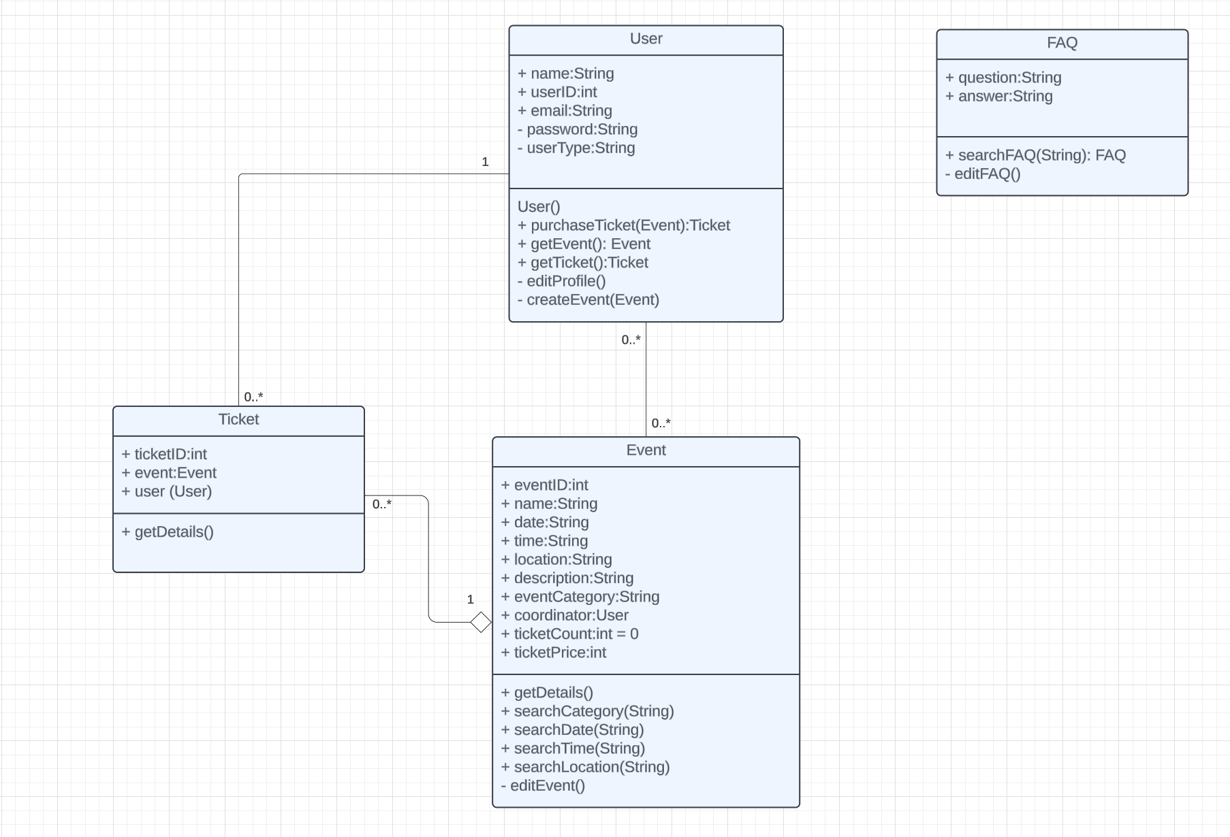
Class Diagram

Slide 14
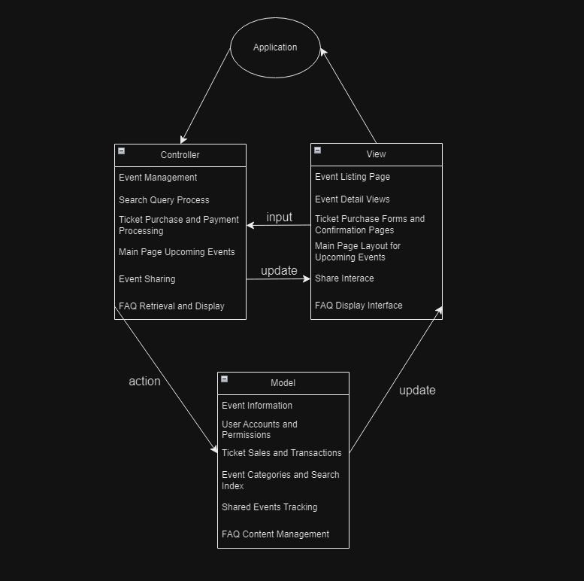
Architecture - Model-View Controller (MVC)

Slide 15
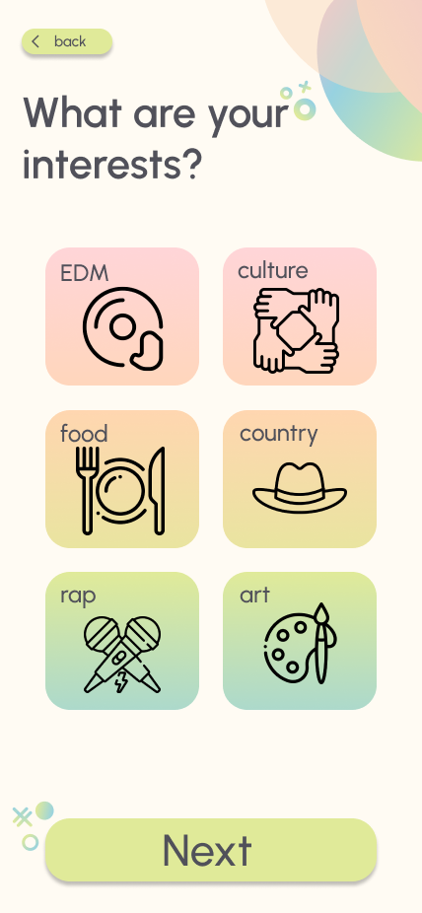
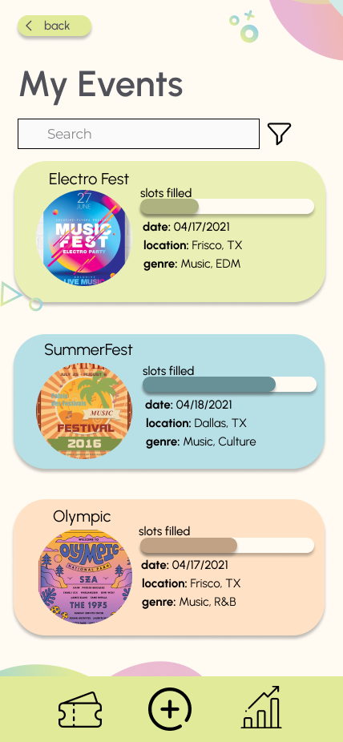

FestGuide Demo

Slide 16
References
[1] Software engineer salary in Texas, https://www.indeed.com/career/software-engineer/salaries/TX (accessed Apr. 19, 2024).
[2] Classiebit.com, “The Ultimate Guide to Event Management Software Cost: Classiebit Software,” classiebit.com, https://classiebit.com/blogs/understanding-the-operational-costs-of-event-ticketing-software-a-breakdown (accessed Apr. 18, 2024).
[3] L. Davey, “The Best Event Management Software: 10 Apps to Plan and Manage Your Business Events,” Zapier, https://zapier.com/blog/best-event-management-software/. (accessed Apr. 19, 2024).
[4] “16 Best Event Management Software,” Scoro, https://www.scoro.com/blog/best-event-management-software/. (accessed Apr. 19, 2024).
[5] “Event Management Platform Comparison,” Cvent, https://www.cvent.com/en/event-management-software (accessed Apr. 19, 2024).

